Slide 1


Department of CSE
COURSE NAME: DBMS
COURSE CODE:24AD2103
Topic: Guidelines For Good Database Design
Session - 16

Slide 2



AIM OF THE SESSION
To familiarize students with the basic concept Database Design
INSTRUCTIONAL OBJECTIVES
This Session is designed to: Guidelines for good database design
LEARNING OUTCOMES
At the end of this session, you should be able to Basic Concept Database Design

Slide 3
GOOD DATABASE DESIGN
Design is the process of creating and planning the construction of a system, or environment. It involves identifying the needs and constraints of the project, developing a concept or idea, and refining it through iteration until a final design is achieved
In the Context of Database Design, it involves creating a structured and organized approach to storing and managing data. The goal of database design is to create a database that is efficient, effective, and easy to use. Database systems are designed to manage large amounts of information that are typically related to the operations of an organization or enterprise. The information stored in a database is often used to support the activities of the organization, whether it is for internal operations or to provide services to customers or clients.
Good Database Design helps organizations avoid these problems and achieve these benefits through efficient data retrieval and manipulation, accurate and secure data, and easy maintenance and updates.
Overall, Good Database Design is essential for organizations that want to effectively manage their data and avoid the consequences of a bad design.

Slide 4
GOOD DATABASE DESIGN (Cont..)
The following six steps has to be followed during its design process
Requirements analysis
Objectives of a Good Database Design
Avoid Redundant Data
Faultless Information
Data Integrity
Easier to retrieve information
Easier Modification
Easy to Maintain
Enhance the quality and consistency of information
Conceptual Database Design
Logical Database Design Schema
Schema Refinement
Physical Database Design
Application and Security Design

Slide 5
GOOD DATABASE DESIGN (Cont..)
Requirements Analysis
In requirement analysis for database design, the main goal is to understand the needs and expectations of the stakeholders for the database system to be developed. The following are the steps involved in requirement analysis for database design:
Identify stakeholders: The first step is to identify the stakeholders who will be using the database system.
Gather requirements: Once the stakeholders are identified, the next step is to conduct interviews or surveys to gather information about their requirements and expectations for the system.
Define functional and non-functional requirements: The information gathered from the stakeholders can then be used to create a list of functional and non-functional requirements for the database system.
After gathering the requirements these requirements are organized and represented using appropriate tools and are given as input to the conceptual database design phase.
Requirements Analysis
Conceptual Database Design
Logical Database Design Schema
Schema Refinement
Physical Database Design
Application and Security Design

Slide 6
GOOD DATABASE DESIGN (Cont..)
Requirements Analysis
Conceptual Database Design
Specifications are converted into ER-Model or Any other similar high level conceptual database design model. The conceptual database design is the first stage of database design
E-Model provides a simple description of the data that matches both how users and developers.
It is a high-level view of the entire database that describes what the database should contain and how the data should be related to each other.
This design is usually presented in an Entity-Relationship (ER) diagram. The main focus is on the overall structure and relationships between entities.
Once the requirement specifications are converted into ER-Model it is given as input to the logical database design phase.
Conceptual Database Design
Logical Database Design Schema
Schema Refinement
Physical Database Design
Application and Security Design

Slide 7
GOOD DATABASE DESIGN (Cont..)
Requirements Analysis
Logical Database Design Schema
The logical database design is the second stage of database design. It focuses on converting the conceptual design into a detailed logical model.
That can be implemented in a database management system (DBMS).
The main focus is on defining the data elements, their relationships, and the data constraints.
This design is usually presented in the form of tables, columns, and relationships
Logical database design means that ER diagrams are now converted into actual relational database schemas, and these relational database schemas are given as input to the schema refinement phase.
Example
Conceptual Database Design
Logical Database Design Schema
Schema Refinement
Physical Database Design
Application and Security Design

Slide 8
SESSION DESCRIPTION (Cont..)
Schema Refinement
Database designed based on the E-R model may have some amount of
  Inconsistency
  Uncertainty
  Redundancy
  Refinement process is called Normalization
  Defined as a step-by-step process of decomposing a complex relation into a simple relations.
  The formal process that can be followed to achieve a good database design
  Also used to check that an existing design is of good quality
  The different stages of normalization are known as “normal forms”
Requirements Analysis
Conceptual Database Design
Logical Database Design Schema
Schema Refinement
Physical Database Design
Application and Security Design

Slide 9
GOOD DATABASE DESIGN (Cont..)
Schema Refinement(Cont..)
Guidelines that may be used as measures to determine the quality of relation schema design:
Guideline:1: Making sure that the semantics of the attributes is clear in the schema
Guideline:2: Reducing the redundant information in tuples
Guideline:3: Reducing the NULL values in tuples
Guideline:4: Disallowing the possibility of generating spurious tuple

Slide 10
GOOD DATABASE DESIGN (Cont..)
Schema Refinement (Cont..)
Guideline:1
Making sure that the semantics of the attributes is clear in the schema
Informally, each tuple in a relation should represent one entity or relationship instance. (Applies to individual relations and their attributes).
Attributes of different entities (EMPLOYEEs, DEPARTMENTs, PROJECTs) should not be mixed in the same relation
Only foreign keys should be used to refer to other entities.
Entity and relationship attributes should be kept apart as much as possible.
Bottom Line: Design a schema that can be explained easily relation by relation. The semantics of attributes should be easy to interpret.

Slide 11
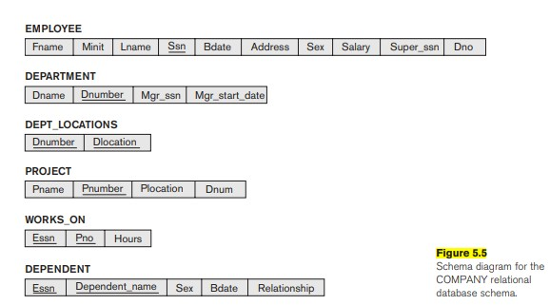
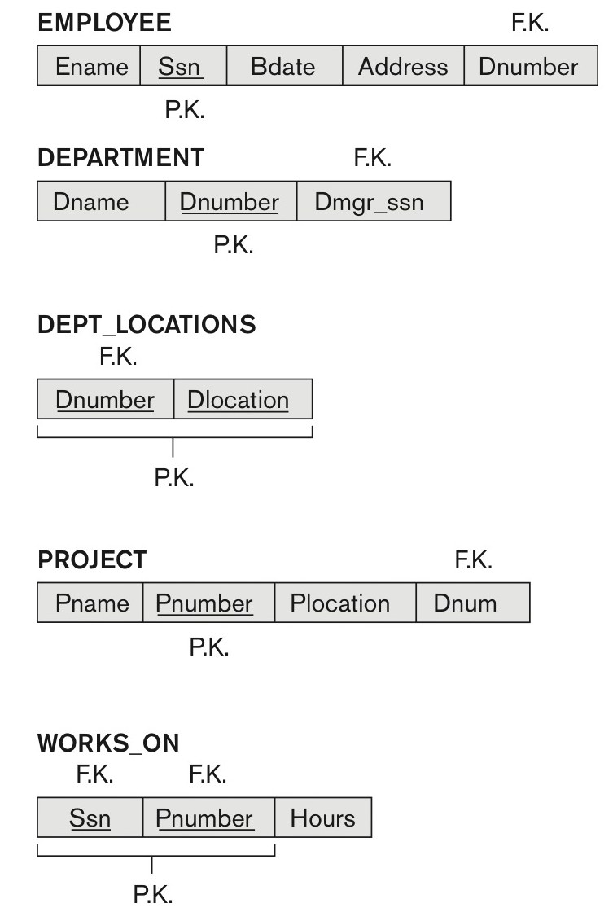
GOOD DATABASE DESIGN (Cont..)
Schema Refinement (Cont..)
Guidelines:1
Making sure that the semantics of the attributes is clear in the schema:
Data Data

Slide 12
GOOD DATABASE DESIGN (Cont..)
Schema Refinement (Cont..)
Redundant Information in Tuples and Update Anomalies
Wastes storage: Grouping attributes into relation schemas has a significant effect on storage space
problems with update anomalies: Storing natural joins of base relations leads to an additional problem referred to as update anomalies.
    Insertion anomalies :To insert a new employee tuple into EMP_DEPT, we must include either the attribute values for the department that the employee works for, or NULLs (if the employee does not work for a department as yet). For example, to insert a new tuple for an employee who works in department number 5, we must enter all the attribute values of department 5 correctly so that they are consistent with the corresponding values for department 5 in other tuples in EMP_DEPT.

Slide 13
GOOD DATABASE DESIGN (Cont..)
Schema Refinement (Cont..)
Redundant Information in Tuples and Update Anomalies
    Deletion anomalies: If we delete from EMP_DEPT an employee tuple that happens to represent the last employee working for a particular department, the information concerning that department is lost inadvertently from the database. This problem does not occur in the database
    Because DEPARTMENT tuples are stored separately
    Modification anomalies: In EMP_DEPT, if we change the value of one of the attributes of a particular department—say, the manager of department 5—we must update the tuples of all employees who work in that department; otherwise, the database will become inconsistent
    It is easy to see that these three anomalies are undesirable and cause difficulties to maintain consistency of data as well as require unnecessary updates that can be avoided; hence, we can state the next guideline.

Slide 14
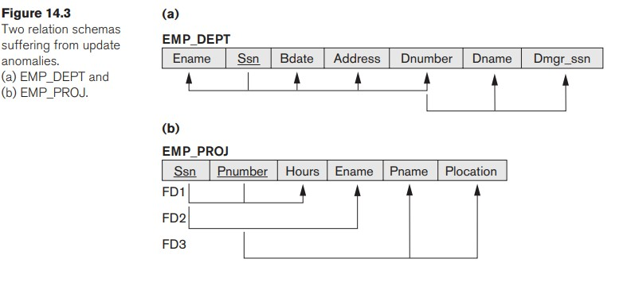
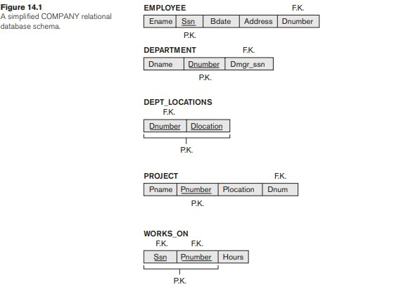
SESSION DESCRIPTION (Cont..)
Schema Refinement(Cont..)
Guideline:2
Reducing the redundant information in tuples :
Design the base relation schemas so that no insertion, deletion, or modification anomalies are present in the relations. If any anomalies are present, note them clearly and make sure that the programs that update the database will operate correctly.
It is important to note that these guidelines may sometimes have to be violated in order to improve the performance of certain n queries.
Example

Slide 15
GOOD DATABASE DESIGN (Cont..)
Schema Refinement(Cont..)
Reducing the NULL values in tuples:
Guidelines:3
  As far as possible, avoid placing attributes in a base relation whose values may frequently be NULL. If NULLs are unavoidable, make sure that they apply in exceptional cases only and do not apply to a majority of tuples in the relation.
Reasons for nulls:
  Attribute not applicable or invalid
  Attribute value unknown (may exist)
  Value known to exist, but unavailable

Slide 16
GOOD DATABASE DESIGN (Cont..)
Schema Refinement (Cont..)
Disallowing the possibility of generating spurious tuple:
Bad designs for a relational database may result in erroneous results for certain JOIN operations.
The "lossless join" property is used to guarantee meaningful results for join operations
Guidelines:4
Design relation schemas so that they can be joined with equality conditions on attributes that are appropriately related (primary key, foreign key) pairs in a way that guarantees that no spurious tuples are generated.
Avoid relations that contain matching attributes that are not (foreign key, primary key) combinations because joining on such attributes may produce spurious tuples.
Example

Slide 17
GOOD DATABASE DESIGN (Cont..)
Requirements Analysis
Physical Database Design
The physical database design is the third and final stage of database design. It focuses on implementing the logical design in a specific database management system by defining the physical database schema.
This includes defining the storage structures, access methods, indexes, and other physical parameters.
The main focus is on how the database will be physically implemented on a specific platform.
Example
Conceptual Database Design
Logical Database Design Schema
Schema Refinement
Physical Database Design
Application and Security Design

Slide 18
GOOD DATABASE DESIGN (Cont..)
Application and Security Design
Application and security design for database management systems (DBMS), there are several key considerations that must be taken into account. Here are some important points to keep in mind:
Authentication and authorization: Implement robust authentication and authorization mechanisms to ensure that only authorized users can access the database. This can include password policies, two-factor authentication, and access control lists.
Logging and monitoring: Implement logging and monitoring to detect unusual activity or unauthorized access attempts.
Auditing: Perform regular audits of the database to ensure compliance with security policies and regulations.
Performance optimization: When designing an application that uses a DBMS, it's important to optimize performance to ensure that the application runs smoothly and efficiently. This may involve using indexing and other performance tuning techniques to speed up database queries.
Backup and recovery: Establish regular backup and recovery procedures to ensure that data is not lost in case of a system failure or data breach
Requirements Analysis
Conceptual Database Design
Logical Database Design Schema
Schema Refinement
Physical Database Design
Application and Security Design

Slide 19
ACTIVITIES/ CASE STUDIES/ IMPORTANT FACTS RELATED TO THE SESSION
Employee Database: A company's employee database can have a relation schema with fields like employee ID, name, address, phone number, email, job title, department, supervisor, and salary.
Product Catalog: An online retailer's product catalog can have a relation schema with fields like product ID, name, description, category, brand, price, availability, and customer reviews.
Customer Order Database: A customer order database can have a relation schema with fields like order ID, customer ID, product ID, order date, delivery date, shipping address, billing address, payment method, and order status.
Library Management System: A library management system can have a relation schema with fields like book ID, title, author, publisher, publication year, ISBN, genre, availability, borrower ID, issue date, return date, and fine amount.
Student Information System: A student information system can have a relation schema with fields like student ID, name, address, phone number, email, course enrolled, semester, marks obtained, attendance, and performance.

Slide 20
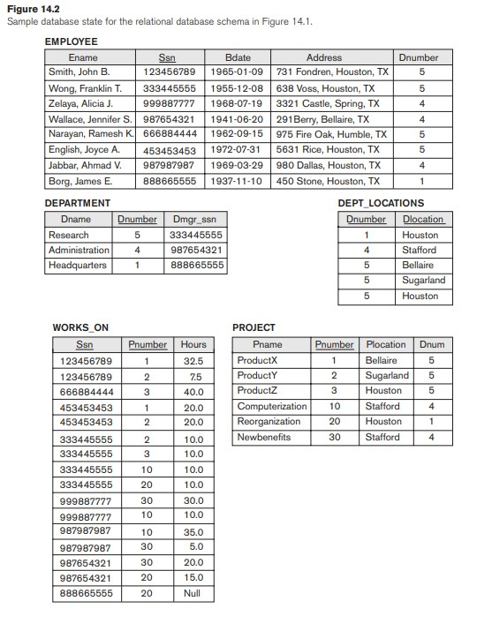
EXAMPLES

Slide 21
SUMMARY
we informally discussed situations that lead to problematic relation schemas and we proposed informal guidelines for a good relational design. The problems we pointed out, which can be detected without additional tools of analysis, are as follows:
Anomalies that cause redundant work to be done during insertion into and modification of a relation, and that may cause accidental loss of information during a deletion from a relation
Waste of storage space due to NULLs and the difficulty of performing selections, aggregation operations, and joins due to NULL values
Generation of invalid and spurious data during joins on base relations with matched attributes that may not represent a proper (foreign key, primary key) relationship
Overall, designing an application that uses a DBMS requires careful consideration of a wide range of factors, from security and access control to performance optimization and scalability. By taking a holistic approach to application and security design, you can create a robust and reliable system that meets the needs of your users while protecting your data from unauthorized access and other threats.

Slide 22
SELF-ASSESSMENT QUESTIONS
The term attribute refers to a ___________ of a table
… Record
… Column
… Tuple
… Key
…. Which one of the following cannot be taken as a primary key?
… Id
… Register number
… Dept id
… Street

Slide 23
TERMINAL QUESTIONS
Identify update anomalies in a relation? What are the common causes of update anomalies?
Analyze How can you ensure that your database design is flexible and adaptable to changes in business requirements? What design principles should you follow to minimize the risk of update anomalies?
List out the key elements of a good database design? How do they contribute to data integrity, security, and consistency?
Explain the benefits of good database design? How does it impact the overall performance of the system?

Slide 24
REFERENCES FOR FURTHER LEARNING OF THE SESSION
Reference Books:
Database System Concepts, Sixth Edition, Abraham Silberschatz, Yale University Henry, F. Korth Lehigh University, S. Sudarshan Indian Institute of Technology, Bombay
Fundamentals of Database Systems, 7th Edition, Ramez Elmasri, University of Texas at Arlington, Shamkant B. Navathe, University of Texas at Arlington.
Raghu RamaKrishnan, Johannes Gehrke, “Database Management Systems”, 3rd edition, Tata McGraw Hill, 2014
Sites and Web links:
(6) Chapter 14 INFORMAL DESIGN GUIDELINES FOR RELATION SCHEMAS FOUR INFORMAL MEASURES: 1. Semantics of Attributes. 2. Reducing redundant values in TUPLES. 3. Reducing Null values in TUPLES. 4. Disallowing possibility of Generating Spurious Tuples | Sharans Kumar - Academia.edu
(5983) Informal Guidelines & Normal Forms (1NF, 2NF, 3NF) for Relation Schemas - Abhishek S. Rao - YouTube

Slide 25
THANK YOU
Team – Course Name

Slide 26
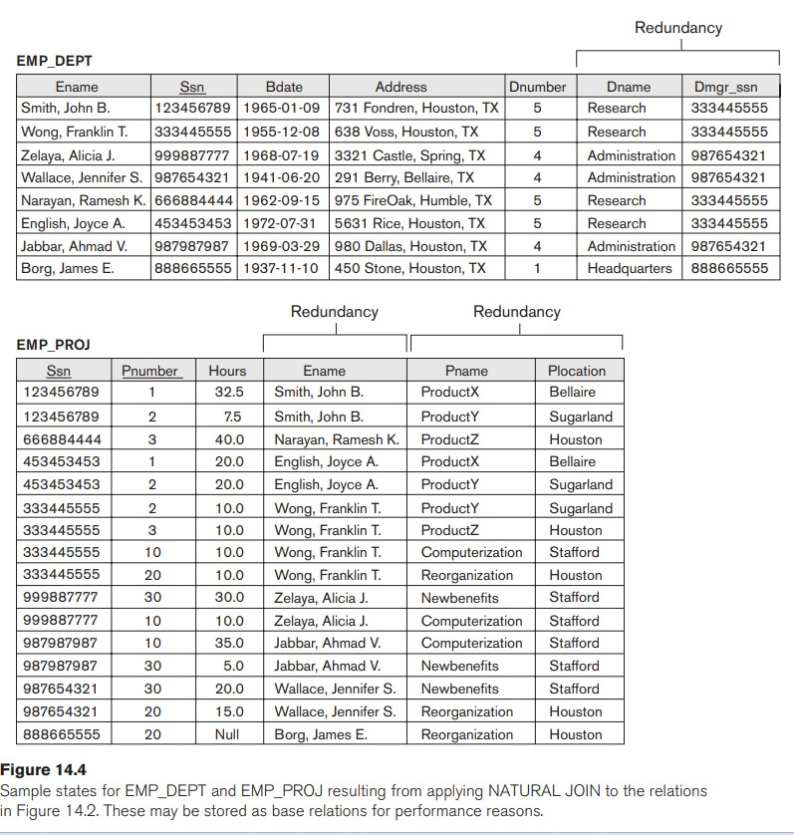
BACK

Slide 27
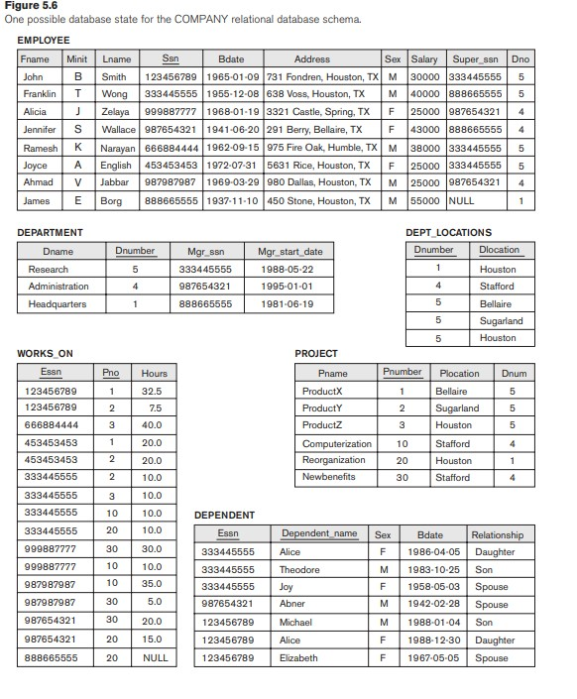
BACK

Slide 28
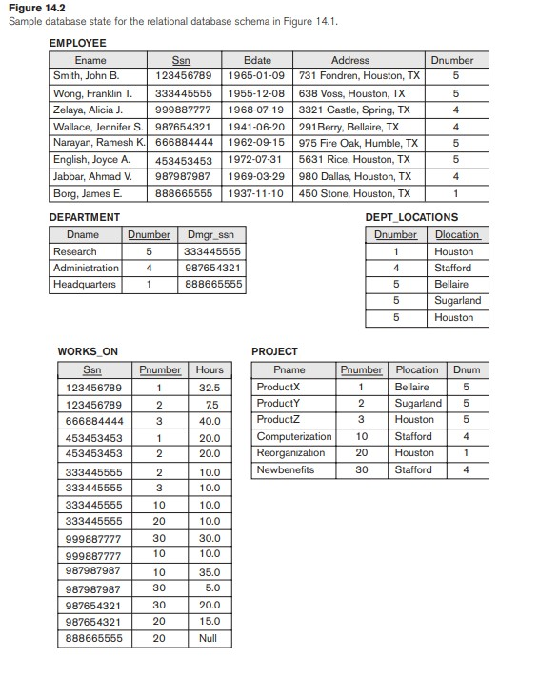
BACK

Slide 29
BACK

Slide 30
BACK

Slide 31
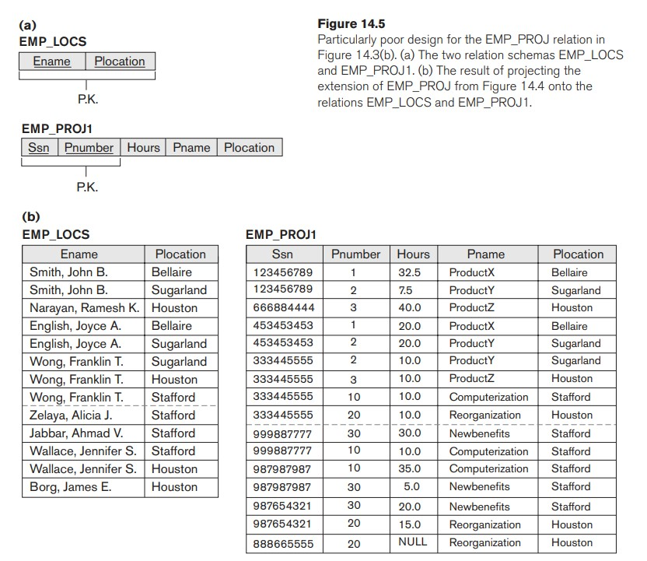
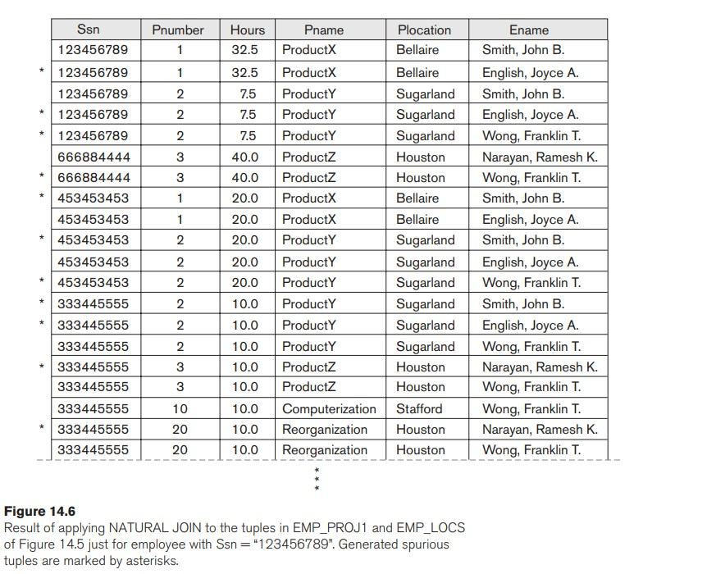
BACK

Slide 32
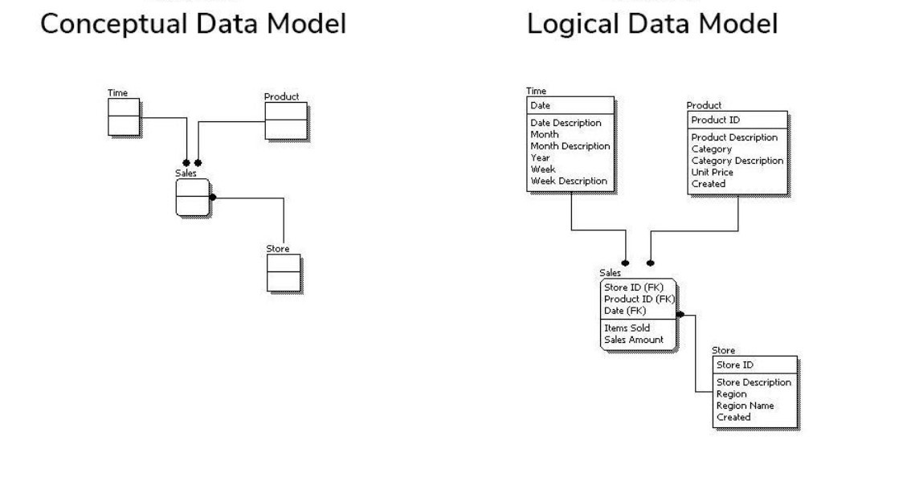
The main focus is on the overall structure and relationships between entities.
The main focus is on defining the data elements, their relationships, and the data constraints.
This design is usually presented in the form of tables, columns, and relationships
BACK

Slide 33
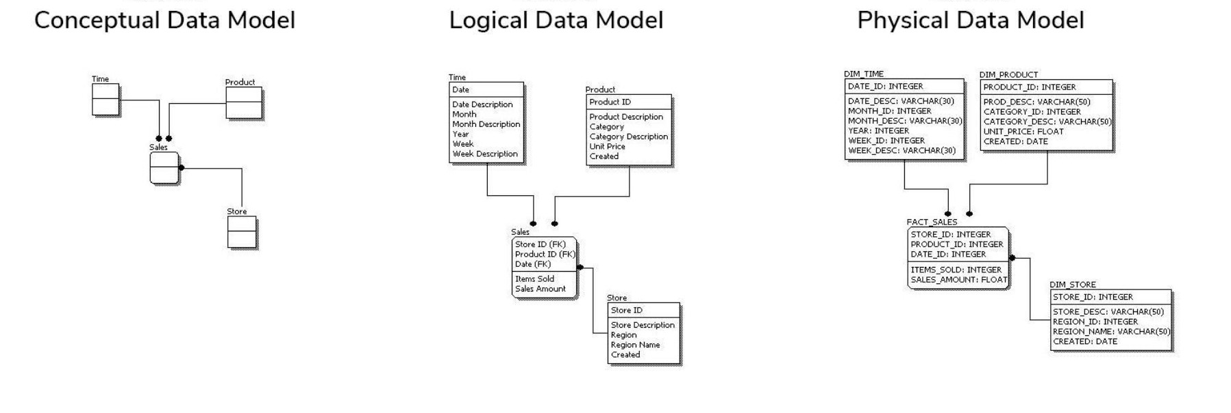
The main focus is on defining the data elements, their relationships, and the data constraints.
This design is usually presented in the form of tables, columns, and relationships
This includes defining the storage structures, access methods, indexes, and other physical parameters.
The main focus is on how the database will be physically implemented on a specific platform.
The main focus is on the overall structure and relationships between entities.
BACK

